Slide 1
Who is on call for you?
Matt Gordon

Slide 2








SQL Saturday New York City 2023
A BIG Thank You to our Sponsors
Platinum
Gold
Bronze

Slide 3

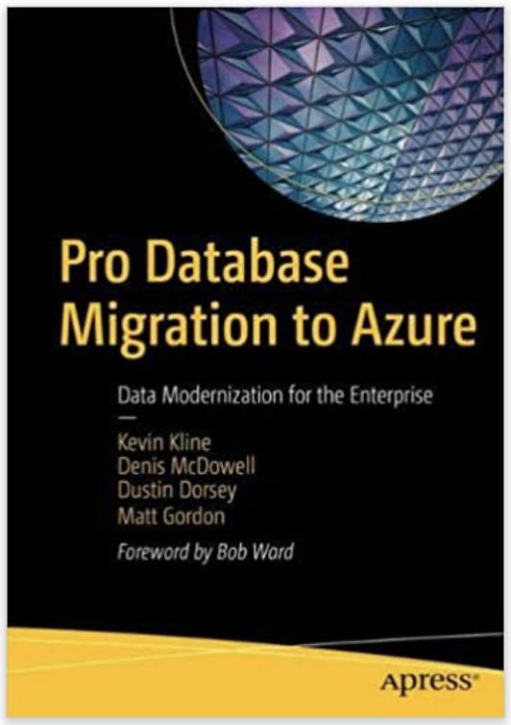

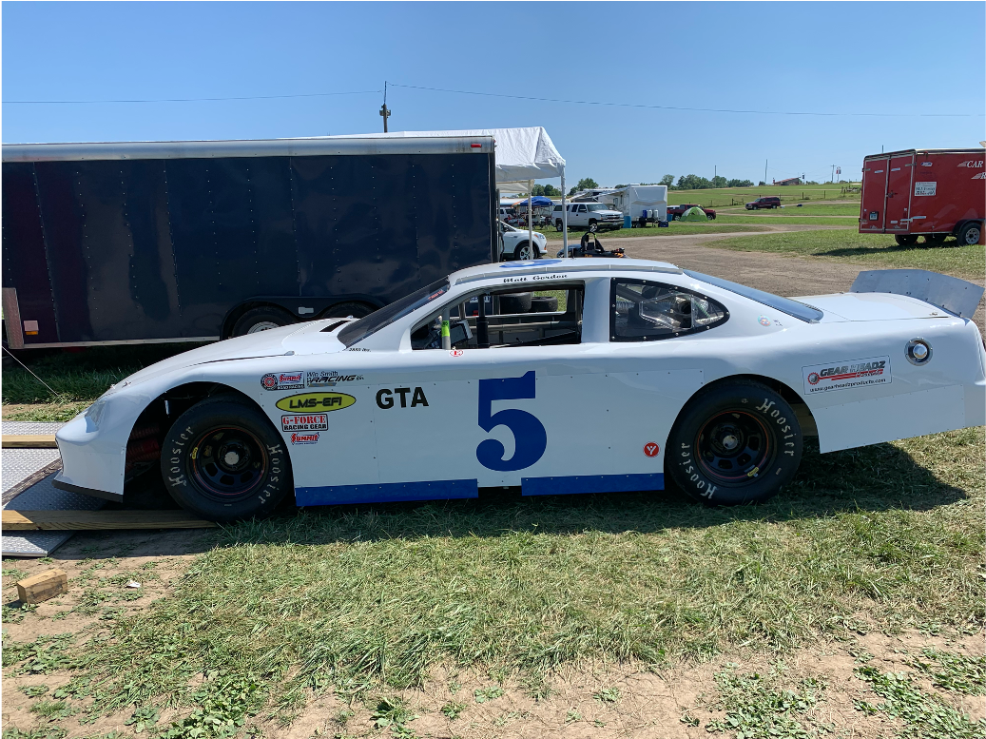

Matt Gordon
Senior Architect
matt@sqlatspeed.com
: @sqlatspeed
www.sqlatspeed.com

Slide 4
POLL
What is your role now?
On-call/operations?
On-call/ops adjacent?
Something else

Slide 5
Agenda
Practical Advice
Let’s Share Stories
Personal Advice
Let’s Share Stories

Slide 6
TECH WORKER BURNOUT IS REAL
According to Yerbo:
43% feel disengaged from their work
51% feel they are achieving less than they should
56% of men/69% of women cannot relax once work is over
Notes:
According to https://report.yerbo.co/

Slide 7
PRACTICAL TIPS

Slide 8
How can we control the information we receive?
MONITORING
MANAGEMENT
ORGANIZATION
Tools
Organized reporting
Proactive alerts
Processes
Procedures
Practice
Documentation
Inter-team responsibilities
Intra-team responsibilities
Escalation points
Notes:
If there is no budget your role/your product is not as critical as you are told it is
Being organized about handling incidents calms us all down

Slide 9
How can we control HOW WE REACT TO THAT INFORMATION?
PROACTIVITY
PATIENCE
FOCUS
Documented processes
Practice makes perfect
Team cross-training
Breathe deeply
Stand up
Move around
Is it my team’s issue?
Should other teams be engaged?
Has anything recently changed in the environment?
Notes:
Remember that organization helps us stay calm
Remember that cross-training the team gets us off the phone/Slack/Teams/etc.
Cordless headset is one of my best investments
Moving around may look silly can be helpful

Slide 10
Personal TIPS

Slide 11
“IF we <MESS> UP, NOBODY DIES”
- Anonymous to protect the innocent ☺

Slide 12
STEP BACK AND GAIN SOME PERSPECTIVE
FAILURE CAN BE DEPRESSING
PRESSURE CAN MAKE DIAMONDS – OR EXPLODE
Not caring doesn’t mean you want to do a bad job
Those “failures” can carry a weight of their own
Make sure your standards are reasonable
SLA pressures are a real thing
Perspective on what’s at stake can bring calm
Focus on problem solving in the moment
Notes:
Point 3, first box – if you are saddled with rickety old code, hardware, etc. hold yourself to reasonable standards and communicate these issues to anyone who will listen
Communicate all the time about SLA issues – soberly and calmly

Slide 13
YOU ARE NOT HIGHLY AVAILABLE
TEAM CARE
SELF-CARE
Provide recovery time around off-hours/on-call work
Perspective on what matters with people’s time
Persistent overtime most likely a failure of management, not people
Take breaks
Go outside and see the sun
Eat!
Notes:
Left box, point 2 – people may have distractions, pressures, weights at home – be mindful of those as you put together schedules
Remember coffee is your friend until it’s not

Slide 14
YOU ARE VALUABLE
PHYSICAL HEALTH
MENTAL HEALTH
Make sure you’re moving
Make sure you’re eating
Make sure you’re sleeping
Journal/Daylio
Connect with community
Express yourself/talk to somebody
Notes:
Want to bring the focus back to just you in this room
Cordless headset again
Left box, point 3 – DND on your phone one of the best things I ever did
TALK TO SOMEBODY – could be friends or a professional, but talking helps…humans crave connection

Slide 15
SQL Saturday New York City 2023
A BIG Thank You to our Sponsors
Platinum
Gold
Bronze

Slide 16
Thanks For Attending!
Matt Gordon
Senior Architect
matt@sqlatspeed.com
: @sqlatspeed
www.sqlatspeed.com
https://github.com/sqlatspeed/2023_presentations

Slide 17
AGENDA
Introduction
Primary goals
Areas of growth
Timeline
Summary

Slide 18
INTRODUCTION
At Contoso, we empower organizations to foster collaborative thinking to further drive workplace innovation. By closing the loop and leveraging agile frameworks, we help business grow organically and foster a consumer-first mindset.​

Slide 19
PRIMARY GOALS
Annual revenue growth

Slide 20
QUARTERLY PERFORMANCE

Slide 21
AREAS OF GROWTH
​ | CATEGORY 1 | CATEGORY 2 | CATEGORY 3​ | CATEGORY 4​
Q1 | 4.5​ | 2.3​ | 1.7​ | 5​.0
Q2 | 3.2​ | 5.1​ | 4.4​ | 3​.0
Q3 | 2.1​ | 1.7​ | 2.5​ | 2.8​
Q4 | 4.5​ | 2.2​ | 1.7​ | 7.0

Slide 22
BUSINESS OPPORTUNITIES ARE LIKE BUSES. THERE'S ALWAYS ANOTHER ONE COMING.​
Richard Branson

Slide 23
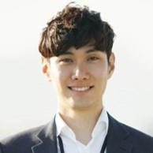


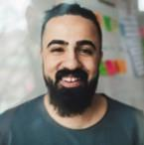
MEET OUR TEAM
TAKUMA HAYASHI
MIRJAM NILSSON
FLORA BERGGREN
RAJESH SANTOSHI
President
Chief Executive Officer
Chief Operations Officer
VP Marketing

Slide 24
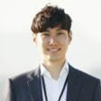







MEET OUR TEAM
TAKUMA HAYASHI
MIRJAM NILSSON
RAJESH SANTOSHI
RAJESH SANTOSHI
President
Chief Executive Officer
Chief Operations Officer
VP Marketing
GRAHAM BARNES
ROWAN MURPHY
ELIZABETH MOORE
ROBIN KLINE
VP Product
SEO Strategist
Product Designer
Content Developer

Slide 25
PLAN FOR PRODUCT LAUNCH
Deploy strategic networks with compelling e-business needs
PLANNING
Synergize scalable e-commerce
MARKETING
Disseminate standardized metrics
DESIGN
Coordinate e-business applications
Foster holistically superior methodologies
LAUNCH
STRATEGY

Slide 26
TIMELINE
Q1
Synergize scalable e-commerce
Q2
Coordinate e-business applications
Q3
Deploy strategic networks with compelling e-business needs
Q4
Disseminate standardized metrics

Slide 27
AREAS OF FOCUS
B2B MARKET SCENARIOS
CLOUD-BASED OPPORTUNITIES
Develop winning strategies to keep ahead of the competition
​Capitalize on low hanging fruit to identify a ballpark value
​Visualize customer directed convergence​
Iterative approaches to corporate strategy
​Establish a management framework from the inside​

Slide 28
HOW WE GET THERE
ROI
NICHE MARKETS
SUPPLY CHAINS
Envision multimedia-based expertise and cross-media growth strategies​
​Engage worldwide methodologies with web-enabled technologies​
Pursue scalable customer service through sustainable strategies​
Engage top-line web services with cutting-edge deliverables​​​
Cultivate one-to-one customer service with robust ideas​
Maximize timely deliverables for real-time schemas​

Slide 29
SUMMARY
At Contoso, we believe in giving 110%. By using our next-generation data architecture, we help organizations virtually manage agile workflows. We thrive because of our market knowledge and great team behind our product. As our CEO says, "Efficiencies will come from proactively transforming how we do business."​

Slide 30
THANK YOU
Mirjam Nilsson
mirjam@contoso.com
www.contoso.com

